Slide 1
OPTICAL CHEMICAL STRUCTURE RECOGNITION
By: Nehal murdeshwar – 210962021
Abhiram Reddy Konda – 210962003
JAYASURYAN MUTYALA - 210962009

Slide 2
Problem Statement
Correctly identify the different bonds and atoms in a hand-drawn chemical structure.

Slide 3
Dataset used
We used a dataset consisting of 9 different molecules each having 40 images, drawn by 3 different people order to prevent overfitting of the model
The training set consists of images of individual bond types and characters which have been extracted from the main dataset.

Slide 4
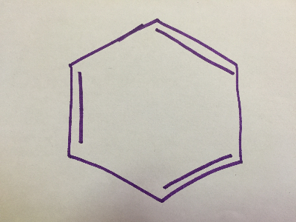
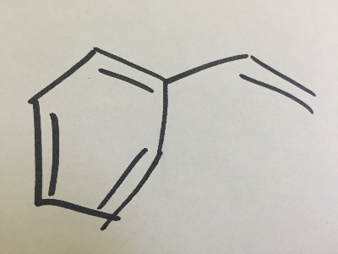
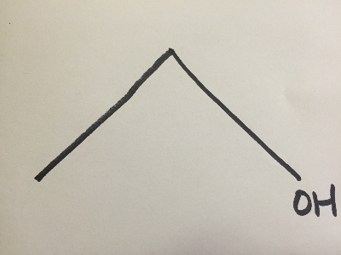
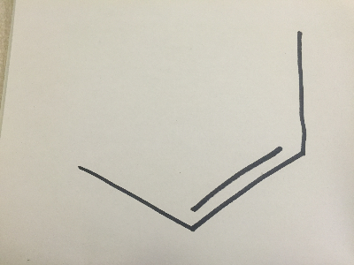
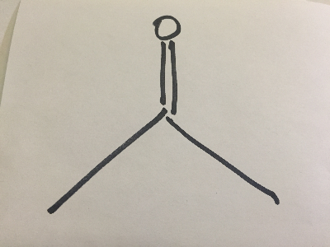
Few examples of images in the dataset
C6H6 - Benzene
C8H8 - Styrene
CH3CH2OH - Ethanol
C4H8 –
cis -2 -Butene
C3H6O - Acetone

Slide 5




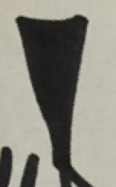






Extracted training set images
Single Bond
Double Bond
Triple Bond
Dashed Bond
Wedged Bond

Slide 6
Why hand-drawn?
Lack of datasets available for digital chemical structure.
Lack of variation in training set for digital images, prone to overfitting.
Challenge of recognising chemical structures from hand-drawn structures.
Lack of readily available software that already does this.

Slide 7
Stepwise structure of the project
Utilisation of scale-invariant template matching for text label recognition
Detection of Corners
Detection of Bonds
Training of Machine Learning Model
Classification of Bonds

Slide 8
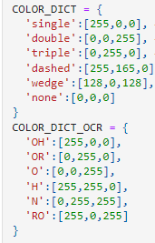
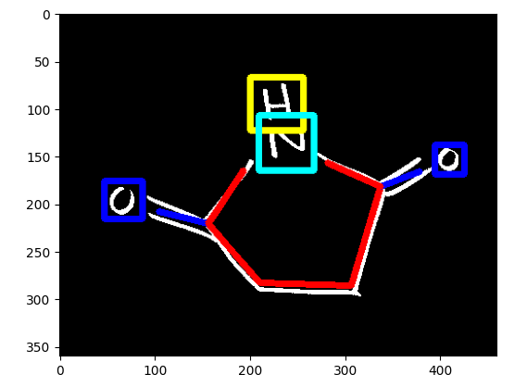
Additional information
We used colour dictionaries to identify the different bonds and texts in our test images.
The dictionaries used along with sample result is as follows:
As you can see, the text and bonds have been correctly identified with respect to the colour dictionary we created.
Single Bond -> Red
Double Bond -> Blue
Hydrogen -> Yellow
Nitrogen -> Cyan
Oxygen -> Blue

Slide 9
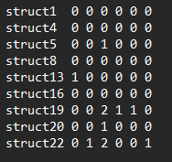

Additional information
We created 2 .txt files, ocr_groundtruth.txt and corners_groundtruth.txt .
corners_groundtruth.txt contains information about the no. of corners each structure has in order to aid the corner detection part of the pipeline.
ocr_groundtruth.txt contains information about the no. of text labels corresponding to the below code.
ocr_groundtruth.txt
corners_groundtruth.txt

Slide 10
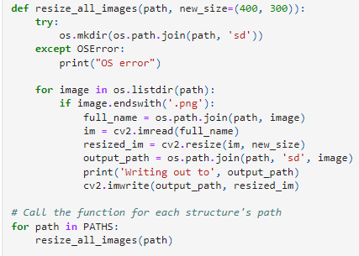
Preprocessing
Since all the images are of different sizes, we used the below code to resize them all to a resolution of 400x300.
Inverse binary thresholding is also done on them before the processing of the images.

Slide 11









Creating template images for text recognition
Created the following template images by combining images. This is later used for template matching and identifying coordinates of bounding boxes for the text labels.
OH, OR, RO underwent a process of deskewing to give the following.

Slide 12
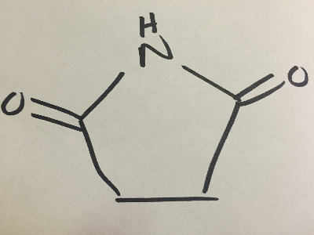
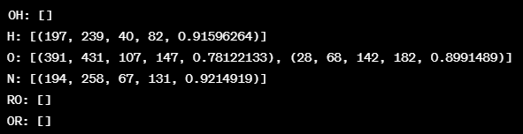
Creation of .pickle files post - template matching
After template matching, a .pickle file is created which contains the coordinates of the bounding boxes of the recognised text labels.
This is done for every image in the dataset.
Example is shown below
*In the format of (x1, y1, x2, y2, accuracy) where x1,y1 are the coordinates of the top-left corner of the bounding box and x2,y2 are the coordinates of the bottom right.

Slide 13
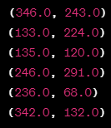
Detection of corners
Corners are detected in all the images using Harris Corner detector.
Their corresponding coordinates are then dumped into a .pickle file which will then be loaded during the time of detection of bonds between these calculated corner coordinates.
The corner coordinates for the following benzene(C6H6) chemical structure are as follows.
6 coordinates due to structure having 6 corners.

Slide 14
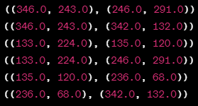
Detection of bonds
These corner .pickle files are then unpickled when detecting edges between the corners.
Canny edge is used here along with hough line transform and other suitable algorithms as taken from our referenced research papers.
After the detection of edges, they are dumped into their respective .pickle files.
*In the format of (x1,y1),(x2,y2) where these two coordinates are the starting and ending point of an edge.

Slide 15
Training of machine learning models
For this project, we tested out 3 different classifiers, them being:
Logistic Regression
Linear Support Vector Machine (Classifier)
Decision Trees

Slide 16

Picking of appropriate model and training
Based on the following accuracies achieved,
We decided to go with Linear Support Vector Machine.
Histogram Of Gradients is used here in order to match the feature detected to the correct label.

Slide 17
Classification of bonds
We now load the .pickle files for edges and templates in order to classify the bonds detected and redraw them on the original image post-processing.
This is the last step of the pipeline as it displays the end results.

Slide 18
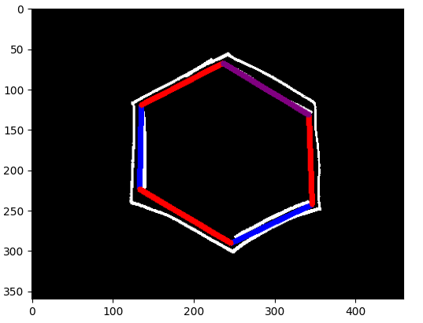
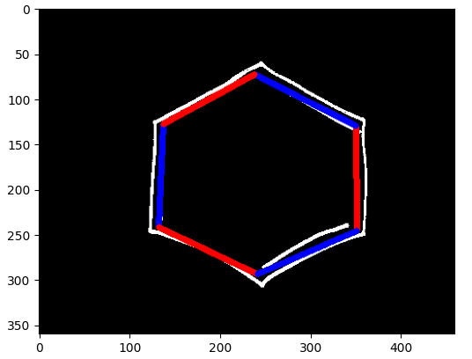
Output
This works for all 40 images of every molecule however only 10 have been displayed as processing them is time consuming. This and the next few slides will display some of the outputs we received.
Incorrectly Identified Structure
Correctly Identified Structure

Slide 19
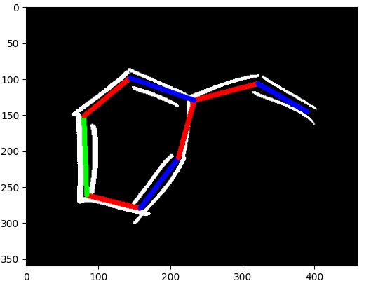
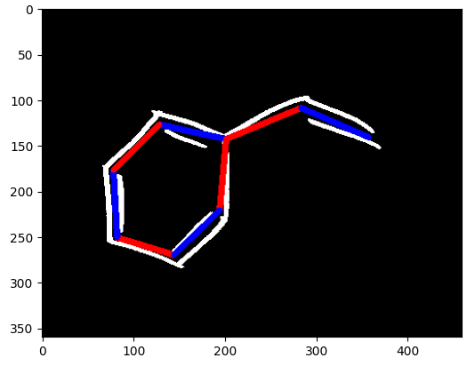
Output
Incorrectly Identified Structure
Correctly Identified Structure

Slide 20
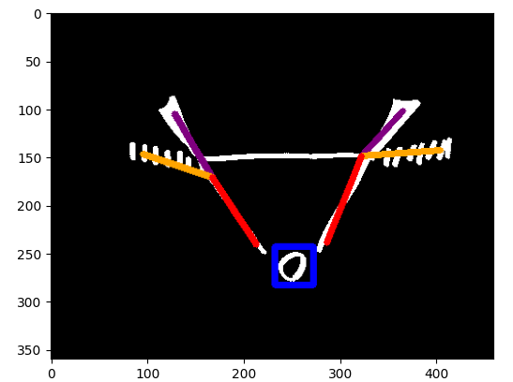
OUTPUT
Correctly Identified Structure

Slide 21
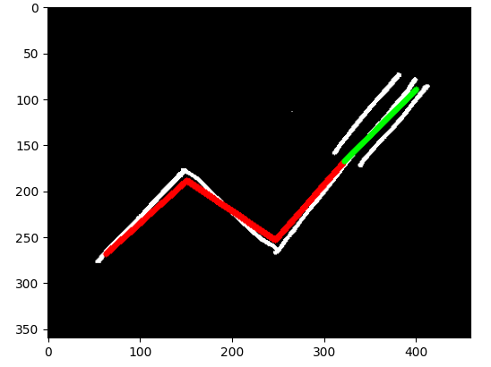
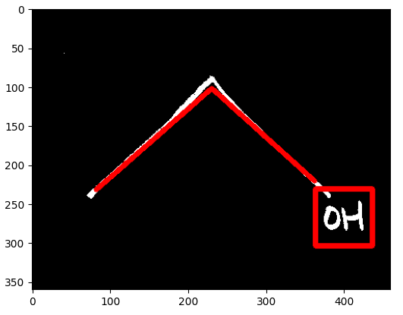
output
Correctly Identified Structure
Correctly Identified Structure

Slide 22
Results
This procedure was done for all 360 images in the dataset.
92 out of 360 images were correctly identified, which puts it at around 25% accuracy.
This is pretty low, but we noticed that the chemical structures with various different bonds and text labels had affected this accuracy significantly and that the simpler structures such as benzene, acetone, ethanol yielded a significantly higher baseline accuracy.

Slide 23
Conclusion
We accept that the low accuracy is due to the limited training set size.
An increase in training set data would help in increasing accuracy.
This coupled with using better OCR engines and better image processing algorithms in the future would yield better results.

Slide 24
Future work
The most obvious case of future work might be the introduction of structure to chemical formula.
This adds another layer of complexity as the mass of molecules will have to be taken into account along with other factors.
However, this project lays reliable enough groundwork for the above to be implemented in the near future.

Slide 25

Thank YOu

